Slide 1
Longitudinal Evaluation of Physician Payment Reform and Team-Based Care on Chronic Disease Management and Prevention NAPCRG Annual Meeting, October 27, 2015
Tara Kiran MD MSc CCFP Dept of Family and Community Medicine, St. Michael’s Hospital, University of Toronto and the Institute for Clinical and Evaluative Sciences
Co-investigators: Alex Kopp, Rahim Moineddin, Rick Glazier

Slide 2
Disclosures
No commercial support or relationships
Board Chair of the St. Michael’s Hospital Academic Family Health Team
Notes:
Provinces took different approaches to reform. In Ontario, the reforms largely involved the creation of new models – introduced between 2002 and 2007.

Slide 3
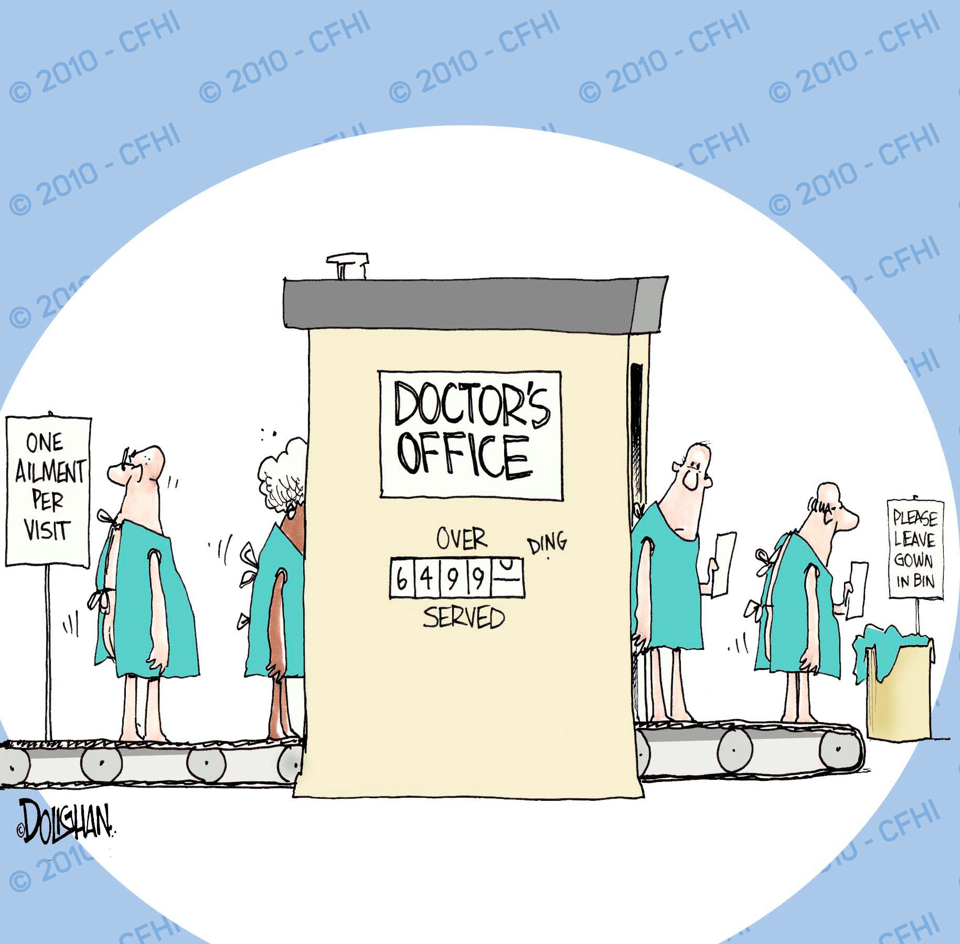
http://www.cfhi-fcass.ca
Notes:
The way you pay your doctor influences quality of care; consensus that feeforservice is suboptimal. Disillusion with FFS in primary care → opportunity for reform

Slide 4
Primary Care Reform in Ontario
Patient-Centred Medical Homes:
Formal patient enrolment
Physicians in groups
Changes in physician payment
Capitation
Pay for performance
Team-based care
Voluntary for both physicians and patients
Notes:
Provinces took different approaches to reform. In Ontario, the reforms largely involved the creation of new models – introduced between 2002 and 2007.

Slide 5
Primary Care Reform in Ontario

Slide 6
Primary Care Reform in Ontario
Enhanced Fee-for-service
Non-team Capitation
Team-based Capitation
Notes:
FHG 80% FFS, 15% capitation 5% incentives
Capitation 20% FFS 70% capitation, 10% incentives

Slide 7
Our question
What was the effect of physician payment reform and inter-professional teams on quality of care?

Slide 8
Study Design
Linked, administrative data
All Ontarians*; all primary care physicians
Patients matched to physicians using enrolment tables and virtual rostering** as of March 31, 2011
*Exclusions: patients attending CHCs
**Assignment based on max value of 18 common primary care fee codes
Notes:
83% enrolled FFS, 93% enrolled capitation

Slide 9
Outcomes
Diabetes Care
Recommended Testing
Age 40+, 1 eye exam, 1 cholesterol test, and 4 HbA1C tests in 24 months prior to Mar 31
Cancer screening
Cervical Age 35-69, pap smear in 30 months prior to Mar 31
Breast Age 50-69, mammogram in 30 months prior to Mar 31
Colorectal Age 50-74, FOBT in 24 months or colonoscopy in 10 years prior to Mar 31
Data Sources: Ontario Health Insurance Plan claims (physician, laboratory, Ontario Breast Screening Program, Ontario Cancer Registry)

Slide 10
Study Design
PCMH
Chronic Disease Prevention
& Management
Enhanced Fee-for-service
Diabetes care
Non-team Capitation
Team-based Capitation
Cancer screening
Notes:
Cross-sectional analysis, 2010/2011:
Poisson regression model using Generalized Estimating Equations to account for clustering by physician
Adjustment for
Patient factors: age, sex, immigration, rurality, co-morbidities, morbidity
Physician factors: age, sex, Canadian Medical Graduate, panel size
“Look-back” 2010/2011 to 2000/2001:
Patients stratified by PCMH type as of March 31, 2011
Patient eligibility for tests and related outcomes calculated annually between 2000/2001 to 2010/2011
Non-linear model (polynomial fractions) fitted to testing rates 2000/2001 to 2010/2011 to assess differences in change over time between models

Slide 11
Study Design
PCMH
Chronic Disease Prevention
& Management
Enhanced Fee-for-service
Diabetes care
Non-team Capitation
Cross-sectional 2011
Adjustment for patient
& physician factors
Team-based Capitation
Cancer screening
Notes:
Cross-sectional analysis, 2010/2011:
Poisson regression model using Generalized Estimating Equations to account for clustering by physician
Adjustment for
Patient factors: age, sex, immigration, rurality, co-morbidities, morbidity
Physician factors: age, sex, Canadian Medical Graduate, panel size
“Look-back” 2010/2011 to 2000/2001:
Patients stratified by PCMH type as of March 31, 2011
Patient eligibility for tests and related outcomes calculated annually between 2000/2001 to 2010/2011
Non-linear model (polynomial fractions) fitted to testing rates 2000/2001 to 2010/2011 to assess differences in change over time between models

Slide 12
Study Design
PCMH
Chronic Disease Prevention
& Management
Enhanced Fee-for-service
Diabetes care
Non-team Capitation
Cross-sectional 2011
Adjustment for patient
& physician factors
2. “Look-back”
Stratified by PCMH 2011
Followed back until 2001
Eligibility and outcomes
assessed each year
Fitted non-linear model
Team-based Capitation
Cancer screening
Notes:
Cross-sectional analysis, 2010/2011:
Poisson regression model using Generalized Estimating Equations to account for clustering by physician
Adjustment for
Patient factors: age, sex, immigration, rurality, co-morbidities, morbidity
Physician factors: age, sex, Canadian Medical Graduate, panel size
“Look-back” 2010/2011 to 2000/2001:
Patients stratified by PCMH type as of March 31, 2011
Patient eligibility for tests and related outcomes calculated annually between 2000/2001 to 2010/2011
Non-linear model (polynomial fractions) fitted to testing rates 2000/2001 to 2010/2011 to assess differences in change over time between models

Slide 13
Results

Slide 14
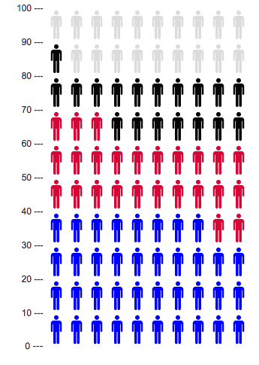
Transition to PCMH in Ontario, 2011
Enhanced Fee-for-service
5.03 million (38%)
Non-team Capitation
3.23 million (25%)
Team-based Capitation
2.41 million (18%)
13,161,935 Ontarians
Notes:
10.7 M in a medical home

Slide 15
Patient Characteristics by PCMH, 2011
Enhanced Fee-for-service
Non-team Capitation
Team-based Capitation
↑ rural, ↓ immigrants

Slide 16
Physician Characteristics by PCMH, 2011
Enhanced Fee-for-service
Non-team Capitation
Team-based Capitation
↑ females, ↑ <age 40, ↑ CMGs, ↓ panel size
13,161,935 Ontarians

Slide 17
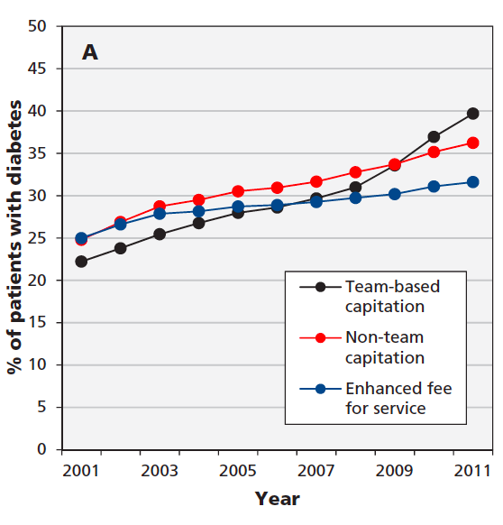
Percentage receiving recommended testing for diabetes
Difference in absolute improvement
over time (95% CI):
Team capitation vs. Non-team capitation:
6.4 (3.8 to 9.1)
Team capitation vs. Enhanced FFS:
10.6 (7.9 to 13.2)
Non-team capitation vs. Enhanced FFS:
4.1 (1.5 to 6.8)

Slide 18
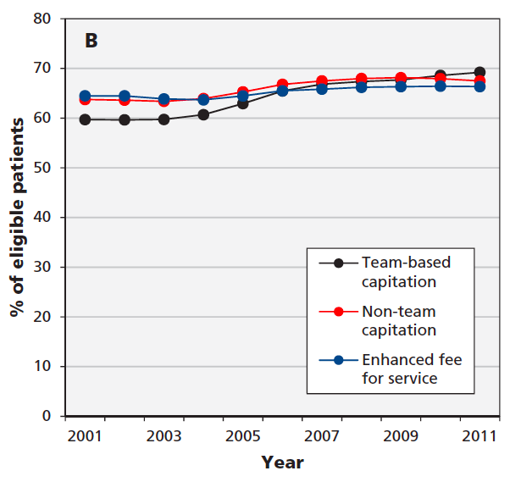
Percentage receiving cervical cancer screening
Difference in absolute improvement
over time (95% CI):
Team capitation vs. Non-team capitation:
5.3 (3.8 to 6.8)
Team capitation vs. Enhanced FFS:
7.0 (5.5 to 8.5)
Non-team capitation vs. Enhanced FFS:
1.7 (0.2 to 3.2)

Slide 19
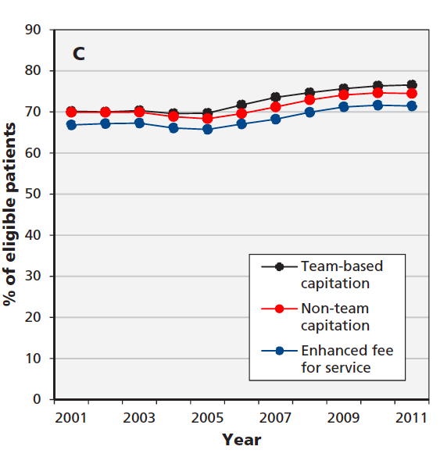
Percentage receiving breast cancer screening
Difference in absolute improvement
over time (95% CI):
Team capitation vs. Non-team capitation:
1.3 (-1.2 to 3.9)
Team capitation vs. Enhanced FFS:
1.7 (-0.9 to 4.2)
Non-team capitation vs. Enhanced FFS:
0.3 (-2.2 to 2.9)

Slide 20
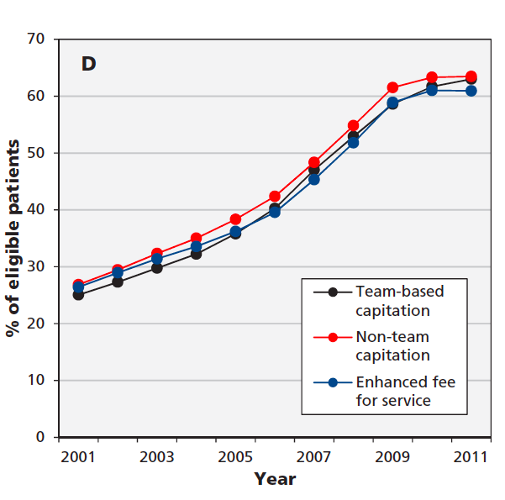
Percentage receiving colorectal cancer screening
Difference in absolute improvement
over time (95% CI):
Team capitation vs. Non-team capitation:
1.3 (-2.1 to 4.8)
Team capitation vs. Enhanced FFS:
2.8 (-0.6 to 6.2)
Non-team capitation vs. Enhanced FFS:
1.4 (-2.0 to 4.9)

Slide 21
Summary
Team-capitation most likely to receive recommended diabetes care and showed greatest improvements over time
Minimal differences related to cancer screening

Slide 22
Limitations
Limits of administrative data:
No data on patient experience or timely access
No laboratory values or blood pressure levels
Retrospective analysis of ‘natural’ health policy experiment, heterogeneous implementation
Differences in patient and physician characteristics by type of PCMH

Slide 23
Discussion
Findings consistent with theory & literature
Are the improvements worth the expense?
What are the ingredients to the ‘secret sauce’?
How can resources be targeted at those most at need?
Notes:
-many reforms introduced at the same time; hard to tease out which components were most important – e.g. type of health professional, co-location, QI training

Slide 24
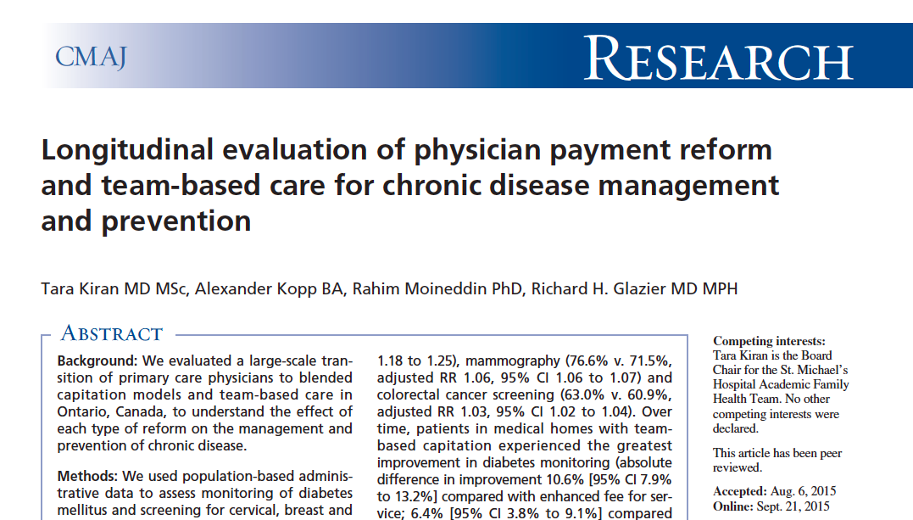
Questions?
tara.kiran@utoronto.ca

Slide 26
Results
10,675,687 Patients:
Team capitation: ↑ rural, ↓ immigrants
Non-team capitation: ↓ low-income, ↓ immigrants
Enhanced FFS: ↑ urban, ↑ immigrants, ↑ co-morbidity, ↑ morbidity
7095 Physicians:
Team capitation: ↑ females, ↑ <age 40, ↑ CMGs, ↓ panel size
Non-team capitation: ↑ CMGs, ↑ panel size
Enhanced FFS: ↑ >age 65, ↓ CMGs

Slide 27
Association between enrolment in primary care model and chronic disease prevention and management after adjustment for patient and physician characteristics, March 31, 2011
Outcomes | Primary Care Model | RR (95% CI)
Cervical cancer screening | Team capitation | 1.00 (0.99 to 1.01)
 | Non-team capitation | 1.01 (1.00 to 1.02)
 | Enhanced FFS | reference
Breast cancer screening | Team capitation | 1.07 (1.06 to 1.08)
 | Non-team capitation | 1.04 (1.03 to 1.05)
 | Enhanced FFS | reference
Colorectal cancer screening | Team capitation | 1.03 (1.02 to 1.04)
 | Non-team capitation | 1.04 (1.03 to 1.05)
 | Enhanced FFS | reference
Recommended testing for diabetes | Team capitation | 1.21 (1.18 to 1.25)
 | Non-team capitation | 1.10 (1.07 to 1.13)
 | Enhanced FFS | reference
Notes:
Delete?

Slide 28
Association between enrolment in primary care model and chronic disease prevention and management after adjustment for patient and physician characteristics, March 31, 2011
Outcomes | Primary Care Model | RR (95% CI)
Cervical cancer screening | Team capitation | 1.00 (0.99 to 1.01)
 | Non-team capitation | 1.01 (1.00 to 1.02)
 | Enhanced FFS | reference
Breast cancer screening | Team capitation | 1.07 (1.06 to 1.08)
 | Non-team capitation | 1.04 (1.03 to 1.05)
 | Enhanced FFS | reference
Colorectal cancer screening | Team capitation | 1.03 (1.02 to 1.04)
 | Non-team capitation | 1.04 (1.03 to 1.05)
 | Enhanced FFS | reference
Recommended testing for diabetes | Team capitation | 1.21 (1.18 to 1.25)
 | Non-team capitation | 1.10 (1.07 to 1.13)
 | Enhanced FFS | reference
Notes:
Delete?

Slide 29
Study Design
Cross-sectional analysis, 2010/2011:
Poisson regression model using Generalized Estimating Equations to account for clustering by physician
Adjustment for
Patient factors: age, sex, immigration, rurality, co-morbidities, morbidity
Physician factors: age, sex, Canadian Medical Graduate, panel size
“Look-back” 2010/2011 to 2000/2001:
Patients stratified by PCMH type as of March 31, 2011
Patient eligibility for tests and related outcomes calculated annually between 2000/2001 to 2010/2011
Non-linear model (polynomial fractions) fitted to testing rates 2000/2001 to 2010/2011 to assess differences in change over time between models

Slide 30
Summary
Team-capitation most likely to receive recommended diabetes care and showed greatest improvements over time
Minimal differences in cancer screening
Enhanced Fee-for-service
Non-team Capitation
Team-based Capitation
Notes:
10.7 M in a medical home

