Slide 1
Those left behind from Ontario’s primary care reforms
Primary Health Care Rounds December 14, 2015
Tara Kiran^{1,2}, Alex Kopp², Rick Glazier^{1,2}
¹Department of Family and Community Medicine, St. Michael’s Hospital, University of Toronto
²Institute for Clinical and Evaluative Sciences

Slide 2


Notes:
Disillusion with FFS in primary care → opportunity for reform

Slide 3
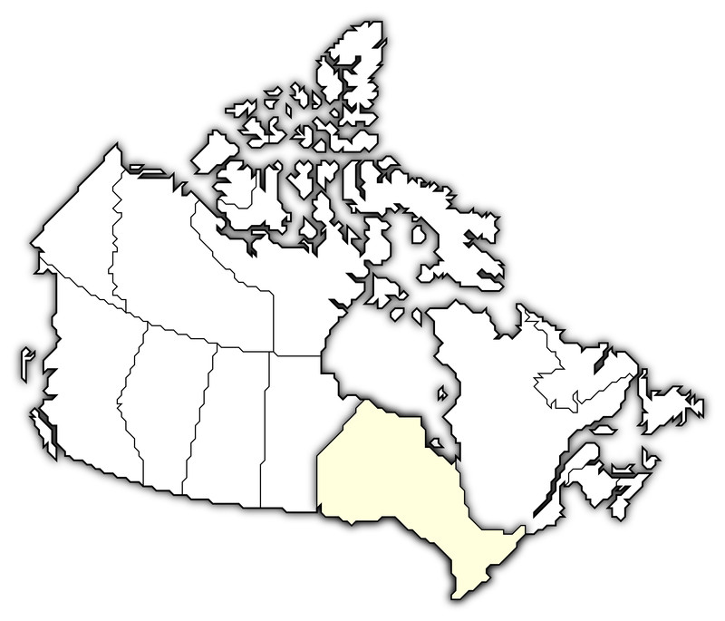

Primary Care Reform in Ontario
Patient Enrolment Models:
Formal patient enrolment
Physicians in groups
Changes in physician payment
  Capitation
  Pay for performance
Team-based care
Voluntary for both physicians and patients
Notes:
Provinces took different approaches to reform. In Ontario, the reforms largely involved the creation of new models – introduced between 2002 and 2007.

Slide 4
Primary Care Reform in Ontario
Patient Enrolment Models:
Formal patient enrolment
Physicians in groups
Changes in physician payment
  Capitation
  Pay for performance
Team-based care
Voluntary for both physicians and patients
Notes:
Provinces took different approaches to reform. In Ontario, the reforms largely involved the creation of new models – introduced between 2002 and 2007.

Slide 5
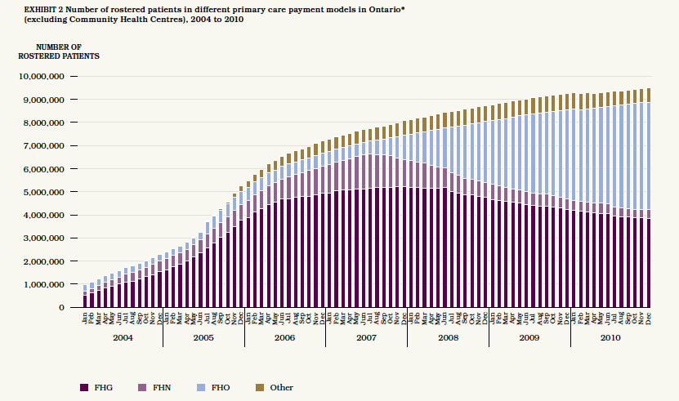
Glazier et al. Comparison of Primary Care Models in Ontario, 2012.
Notes:
FHG 2003 (CCM 2005); FHN 2002, FHO 2007; FHT 2005

Slide 6
Those left behind
Glazier et al. Comparison of Primary Care Models in Ontario, 2012.
Notes:
FHG 2003 (CCM 2005); FHN 2002, FHO 2007; FHT 2005

Slide 7
Our Objectives
Understand characteristics of patients and physicians left behind from reforms
Assess quality of care for patients left behind

Slide 8
Methods
Linked, administrative data
All Ontarians*; all primary care physicians
Patients matched to physicians using enrolment tables and virtual rostering** as of March 31, 2011
  *Exclusions: patients attending CHCs
  **Assignment based on max value of 18 common primary care fee codes

Slide 9




Those left behind
“Comprehensive” FFS
  Worked at least 50 days per year
  Services billed reflected core primary care
  Did not have a “focused practice” designation (e.g. hospitalist, psychotherapy)
Non-comprehensive FFS
No primary care visit in last 2 years

Slide 10


Outcomes
  Diabetes Care
  Recommended Testing
  Age 40+, 1 eye exam, 1 cholesterol test, and 4 HbA1C tests in 24 months prior to Mar 31
  Cancer screening
  Cervical Age 35-69, pap smear in 30 months prior to Mar 31
  Breast Age 50-69, mammogram in 30 months prior to Mar 31
  Colorectal Age 50-74, FOBT in 24 months or colonoscopy in 10 years prior to Mar 31
  Data Sources: OHIP claims (physician, laboratory, OBSP, OCR)

Slide 11


Study Design
Those Left Behind
Chronic Disease Prevention
& Management
FFS Comprehensive
Diabetes care
FFS Non-Comprehensive
Patient enrolment model
Cancer screening
Notes:
Cross-sectional analysis, 2010/2011:
Poisson regression model using Generalized Estimating Equations to account for clustering by physician
Adjustment for
Patient factors: age, sex, immigration, rurality, co-morbidities, morbidity
Physician factors: age, sex, Canadian Medical Graduate, panel size
“Look-back” 2010/2011 to 2000/2001:
Patients stratified by PCMH type as of March 31, 2011
Patient eligibility for tests and related outcomes calculated annually between 2000/2001 to 2010/2011
Non-linear model (polynomial fractions) fitted to testing rates 2000/2001 to 2010/2011 to assess differences in change over time between models

Slide 12
Study Design
Those Left Behind
Chronic Disease Prevention
& Management
FFS Comprehensive
Diabetes care
FFS Non-Comprehensive
Cross-sectional 2011
Adjustment for patient
factors
Patient enrolment model
Cancer screening
Notes:
Cross-sectional analysis, 2010/2011:
Poisson regression model using Generalized Estimating Equations to account for clustering by physician
Adjustment for
Patient factors: age, sex, immigration, rurality, co-morbidities, morbidity
Physician factors: age, sex, Canadian Medical Graduate, panel size
“Look-back” 2010/2011 to 2000/2001:
Patients stratified by PCMH type as of March 31, 2011
Patient eligibility for tests and related outcomes calculated annually between 2000/2001 to 2010/2011
Non-linear model (polynomial fractions) fitted to testing rates 2000/2001 to 2010/2011 to assess differences in change over time between models

Slide 13
Study Design
Those Left Behind
Chronic Disease Prevention
& Management
FFS Comprehensive
Diabetes care
FFS Non-Comprehensive
Cross-sectional 2011
Adjustment for patient
factors
2. “Look-back”
Stratified by attachment in 2011
Followed back until 2001
Eligibility and outcomes
assessed each year
Patient enrolment model
Cancer screening
Notes:
Cross-sectional analysis, 2010/2011:
Poisson regression model using Generalized Estimating Equations to account for clustering by physician
Adjustment for
Patient factors: age, sex, immigration, rurality, co-morbidities, morbidity
Physician factors: age, sex, Canadian Medical Graduate, panel size
“Look-back” 2010/2011 to 2000/2001:
Patients stratified by PCMH type as of March 31, 2011
Patient eligibility for tests and related outcomes calculated annually between 2000/2001 to 2010/2011
Non-linear model (polynomial fractions) fitted to testing rates 2000/2001 to 2010/2011 to assess differences in change over time between models

Slide 14
Results

Slide 15
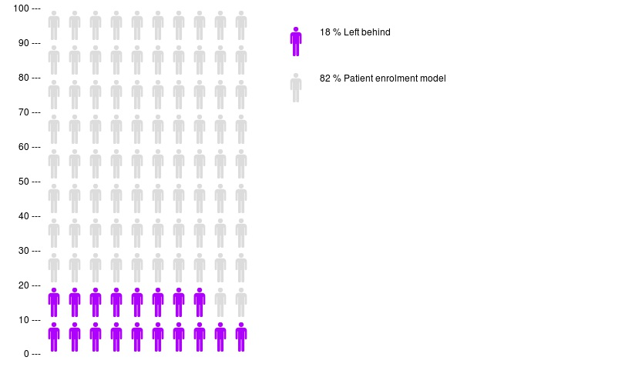
Those left behind
18% left behind
82% patient enrolment model

Slide 16
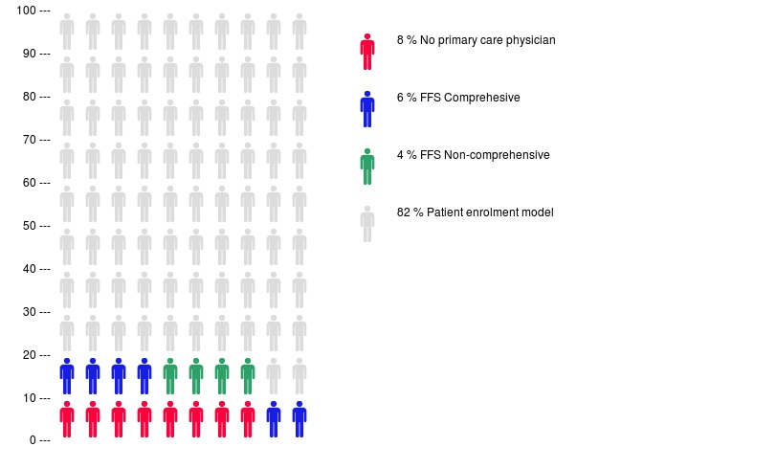
Those left behind
8% no primary care visit
6% FFS comprehensive
4% FFS non-comprehensive
82% patient enrolment model
13,161,935 Ontarians

Slide 17
Those left behind: Patient Characteristics
No primary care visit:
low income, immigrant, healthy
FFS comprehensive:
low income, urban, immigrant
FFS non-comprehensive:
urban, <19yo
Patient enrolment model

Slide 18
Those left behind: Physician Characteristics
No physician
FFS comprehensive:
IMG, <40 or 65+, small panels
FFS non-comprehensive
IMG, <40 or 65+, small panels

Slide 19
Those with no primary care visit in 2 years
Diabetes testing: 7%
Cervical screening: 8%
Breast screening: 11%
Colorectal screening: 12%

Slide 20
Those left behind: Percentage receiving recommended testing for diabetes
34%
25%
23%
Patient enrolment model
FFS Comprehensive
RR 0.74 (0.73 to 0.75)
FFS Non-Comprehensive
RR 0.68 (0.67 to 0.70)

Slide 21
Those left behind: Percentage receiving cervical cancer screening
66%
52%
50%
Patient enrolment model
FFS Comprehensive
RR 0.79 (0.79 to 0.79)
FFS Non-Comprehensive
RR 0.76 (0.75 to 0.76)

Slide 22
Those left behind: Percentage receiving breast cancer screening
73%
60%
58%
Patient enrolment model
FFS Comprehensive
RR 0.80 (0.80 to 0.81)
FFS Non-Comprehensive
RR 0.81 (0.81 to 0.82)

Slide 23
Those left behind: Percentage receiving colorectal cancer screening
62%
45%
44%
Patient enrolment model
FFS Comprehensive
RR 0.72 (0.71 to 0.72)
FFS Non-Comprehensive
RR 0.73 (0.72 to 0.74)

Slide 24
Summary
2.4 million patients left behind
Those left behind less likely to receive recommended testing for diabetes and cancer screening
Differences in quality of care preceded introduction to medical homes
Patients seeing “comprehensive” FFS MDs were more likely to be urban, low income, new immigrants

Slide 25
Limitations
Limits of administrative data:
  No data on patient experience or timely access
  No laboratory values or blood pressure levels
  Cannot distinguish walk-in clinics or measure true attachment

Slide 26
Discussion
Voluntary reforms risk leaving the vulnerable behind
  Many of those left behind likely have no regular family doctor
    Walk-in clinics: more prominent in urban areas
  Ontario’s capitation payments did not adjust for co-morbidity or SES
  Characteristics of MDs who stayed FFS

Slide 27
Discussion
We need policy solutions to improve care for those left behind
  Improved attachment
  Improved services with existing physician

Slide 28
Those left behind
Questions?

