Slide 1
Research Finance Petty Cash Float Virtual Drop-In
June 11th, 2024

Slide 2
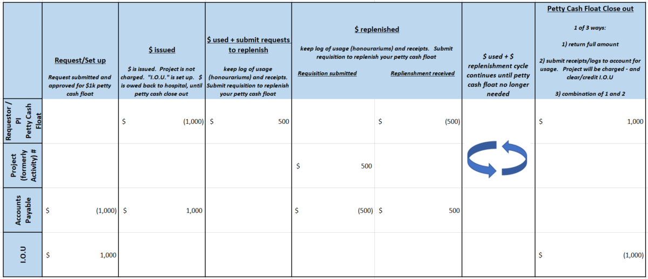
Petty Cash Float – life cycle

